Slide 1
Convolutional Neural Network for Multiclass Image Classification of Filipino Dishes)
Presented by: Group 8
CloudMojos/Data-Analytics-Project: Image Classifier (github.com)

Slide 2
Introduction & Hypothesis
Aims to develop and evaluate a Convolutional Neural Network (CNN) for the task of multiclass image classification of Filipino Dishes.
Contributes to the development of models that can automate the task of classifying various Filipino dishes from images.
  In food industry: food delivery apps and recipe search engines.
Null Hypothesis (H0): The proposed CNN model will not achieve a classification accuracy of more than 75% on the dataset of Filipino dishes.
Alternative Hypothesis (H1): The proposed CNN model will achieve a classification accuracy of more than 75% on the dataset of Filipino dishes.

Slide 3
Methods and Experimental Logic
Gather dataset
Preprocess the data
Split the dataset into validation and training
Build the model
Compile the model
Train the model
Evaluate the model
Fine-tune and optimization
Save the model

Slide 4
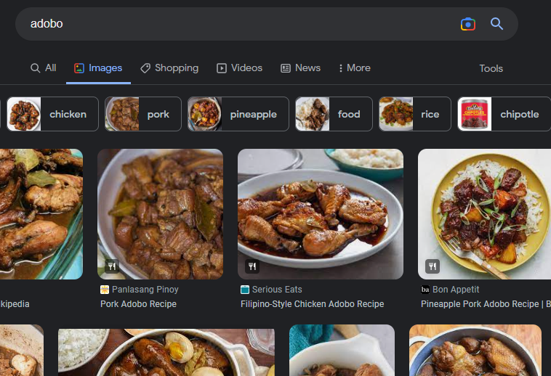
Gather Dataset

Slide 5
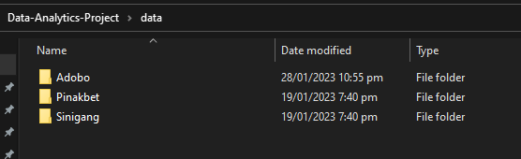



Gather dataset

Slide 6
Preprocess data
Criteria
Coherent with the dataset
Contains the attributes of the class
File can be read by the code
Split the data
0.2 Validation Split
  80% Training
  20% Validation

Slide 7
Change Screen to Jupyter Lab 👉

Slide 8
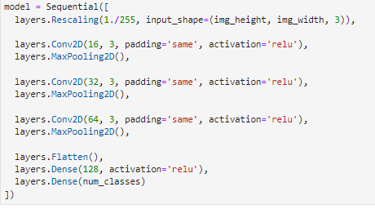
Build and compile the model

Slide 9

Build and compile the model

Slide 10

Train the model

Slide 11
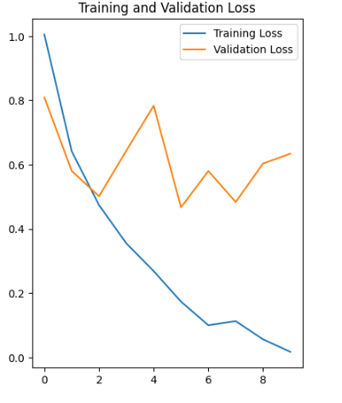
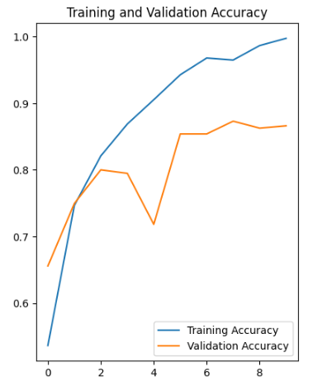
Analyzing the result

Slide 12
Analyzing the result

Slide 13
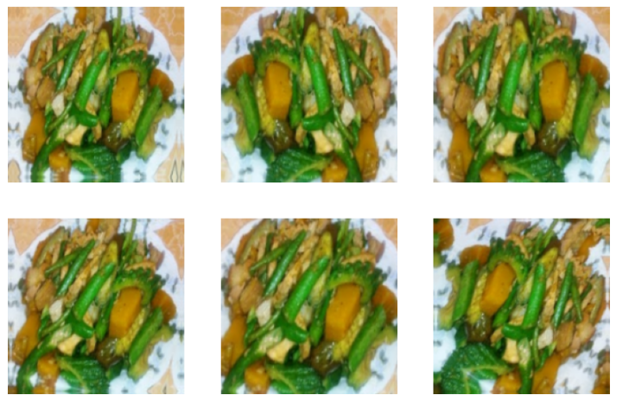
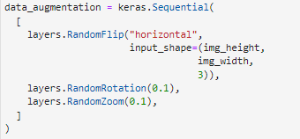
Regularization

Slide 14
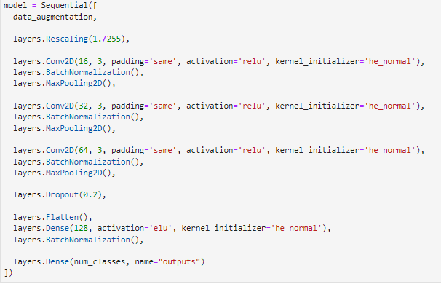
Regularization

Slide 15

Regularization

Slide 16
Regularization

Slide 17
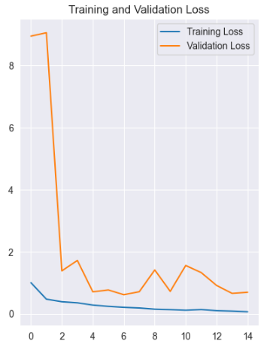
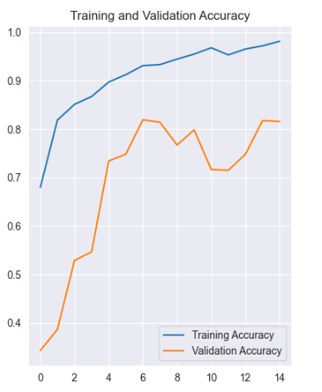
Analyzing result

Slide 18
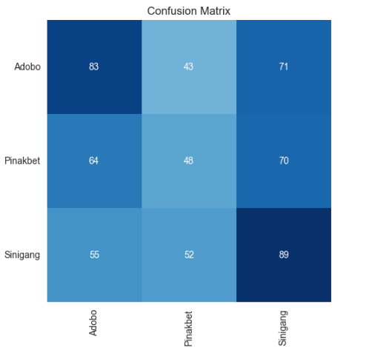
Analyzing result

Slide 19
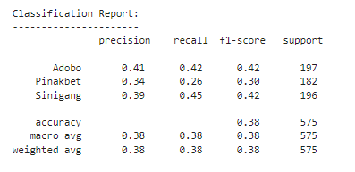
Analyzing result

Slide 20
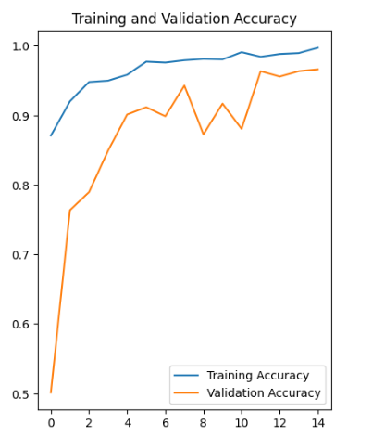
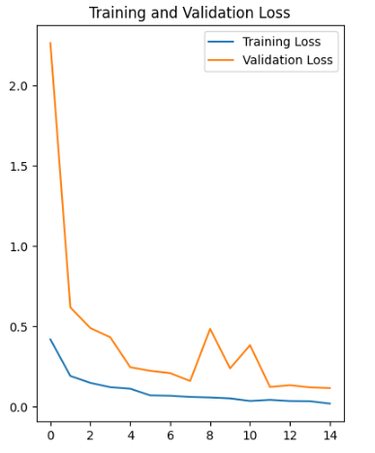
The model on Adobo and Sinigang only

Slide 21
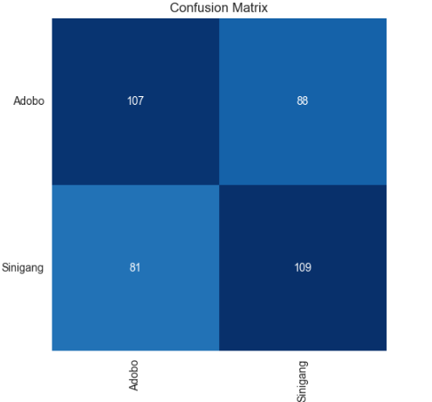
The model on Adobo and Sinigang only

Slide 22
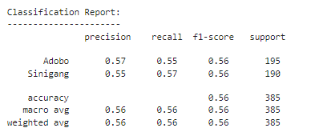
The model on Adobo and Sinigang only

Slide 23
Thank you for listening 🎉🎊
Simon Daniel Dela Cruz
Joshuel Ernest Simbulan
Andrew James Tejerero
Mark Zaired Ugay

